Slide 1
Do you think society’s perception of beauty is distorted?
Why, or why not?

Slide 2
What are the lengths that people will go to be considered “beautiful”?
Let’s take a look….

Slide 3
What does the word “beautiful mean to you?

Slide 4
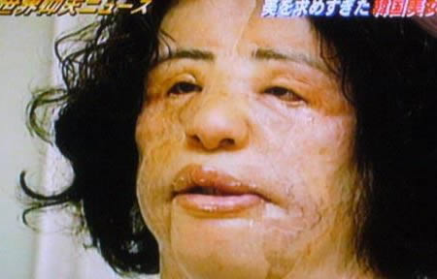
Botox injections and Cosmetic Surgery
Injected cooking oil into her body trying to simulate a botox treatment.

Slide 5
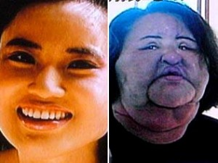
Injected cooking oil into her body trying to simulate a botox treatment.

Slide 6
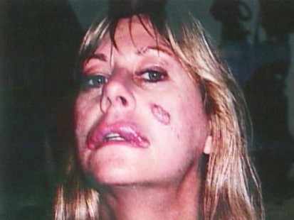
Ordered botox online and performed the procedure at home.

Slide 7
So, let me ask you again….
Does society influence our perception of beauty?

Slide 8
How does this slide show relate to the poem “Barbie doll”

